Slide 1
Expanding Horizons: An Unforgettable Exchange Experience at NCU

Slide 2
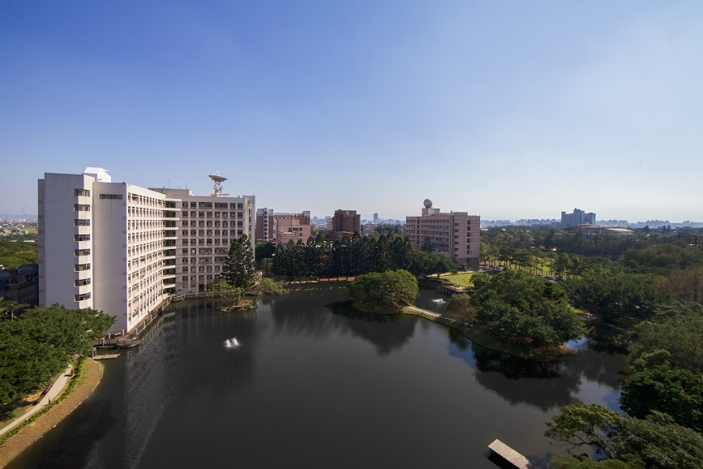
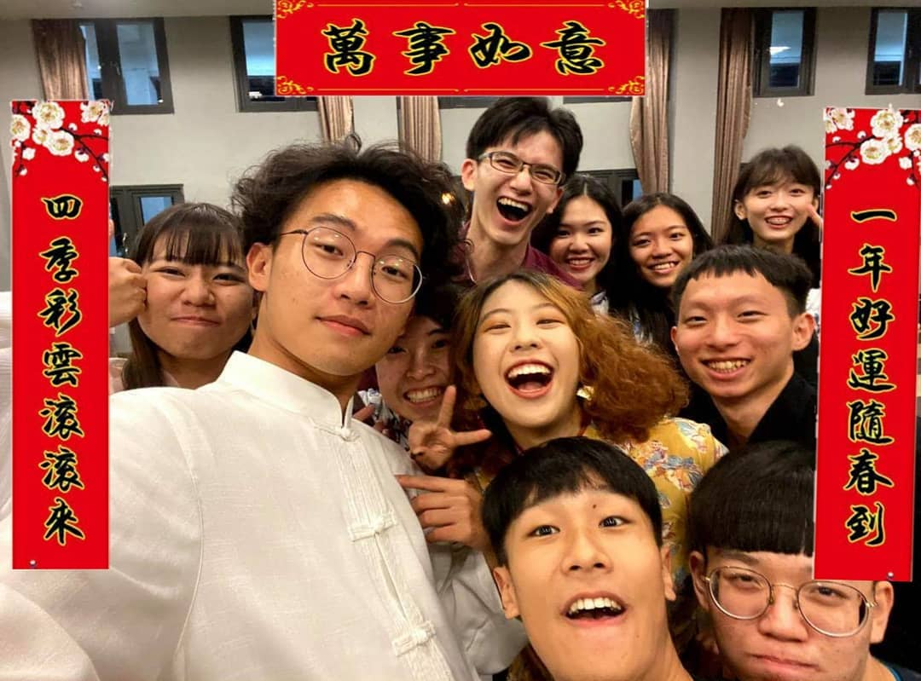
01
Introduction of Taiwan
02
NCU Introduction
03
NCU International Exchange Program

Slide 3



Introduction of Taiwan

Slide 4
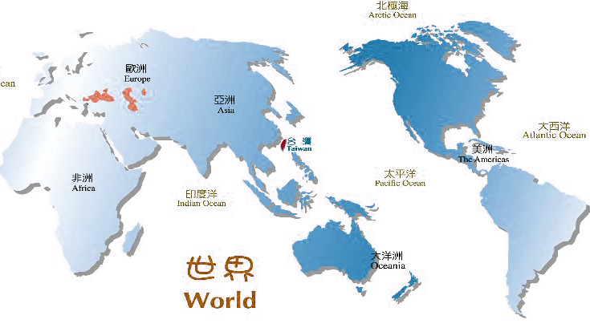


Where is Taiwan ?
Hello!
COME to be
MY FRIEND!
Taiwan Black Bear

Slide 5

Taiwan Briefing
Capital
Taipei
Population
23 million
Area
36,000 square kilometers
Weather
an average: 22C (71.6F);
highest temperature up to 38C (100F)
the lowest temperature to 10C (50F)
Language
Mandarin / Taiwanese / Hakka / Indigenous Languages
Religion
Buddhism / Taoism / Christianity / Islam

Slide 6
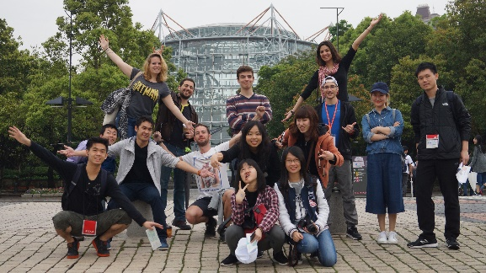



Why Taiwan?
Affordable living cost
Friendly People
The Nature Beauty

Slide 7


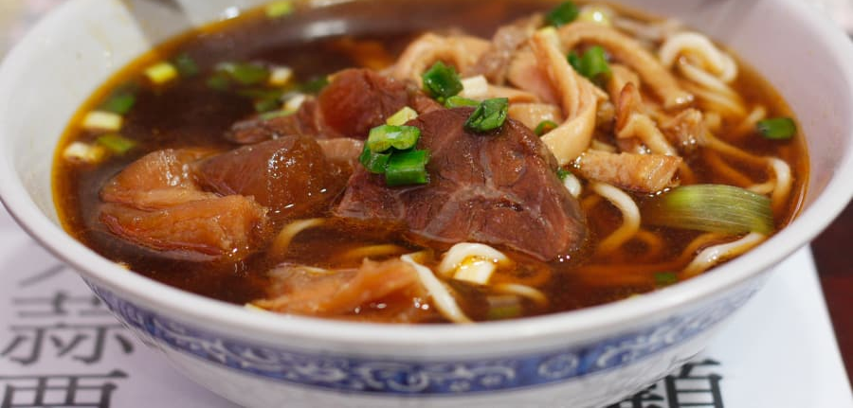
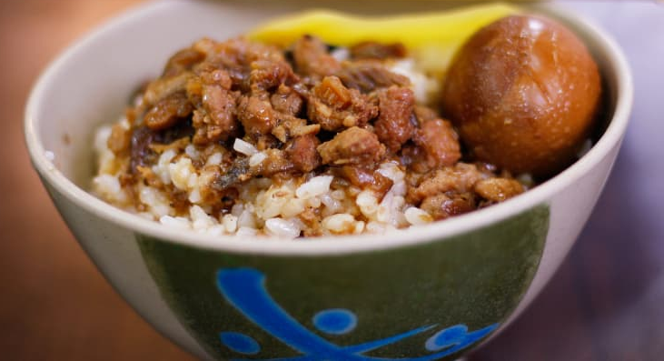
Discover a wide range of delicious Taiwanese food and drinks
Bubble milk tea
Fried Chicken cutlet
Beef noodle
Braised pork rice

Slide 8
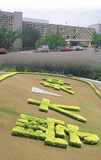
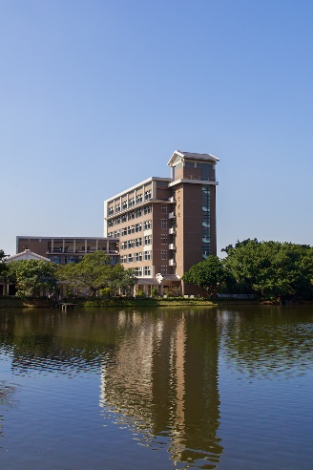
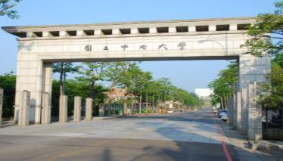
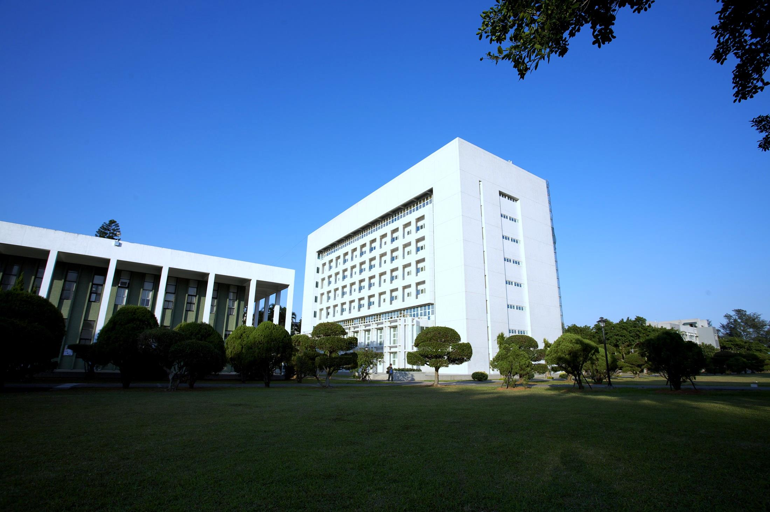
NCU Introduction

Slide 9
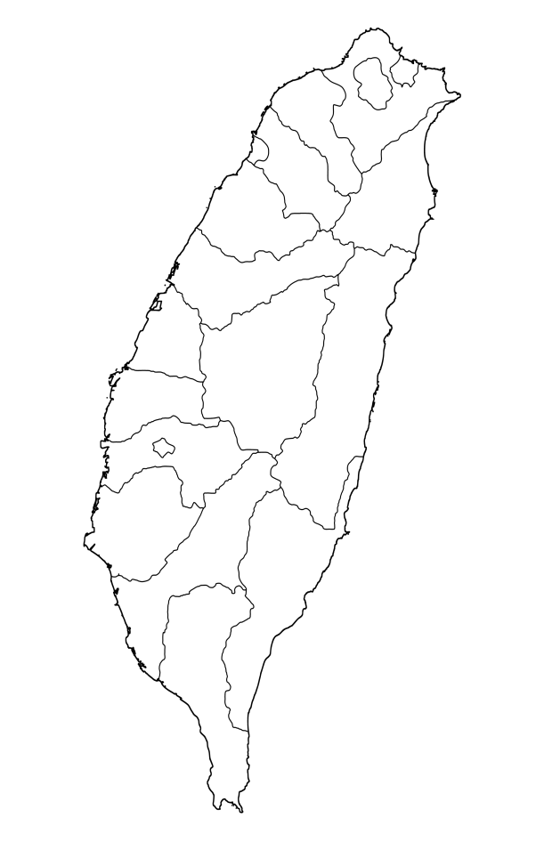


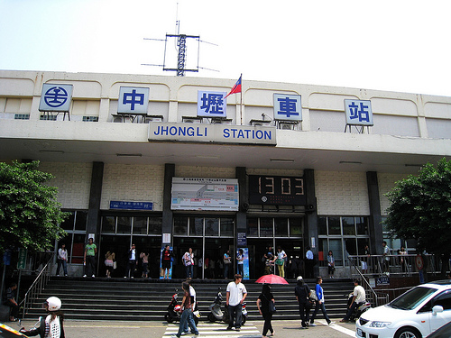
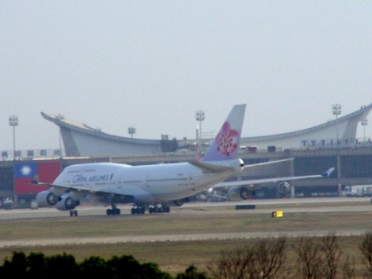
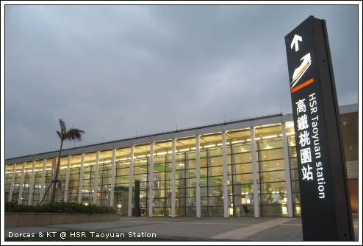
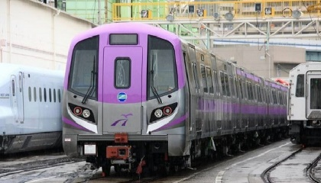
Location of NCU
Taoyuan
Taipei
 Taipei

Taichung
NCU
Hualien
Kaohsiung

Slide 10
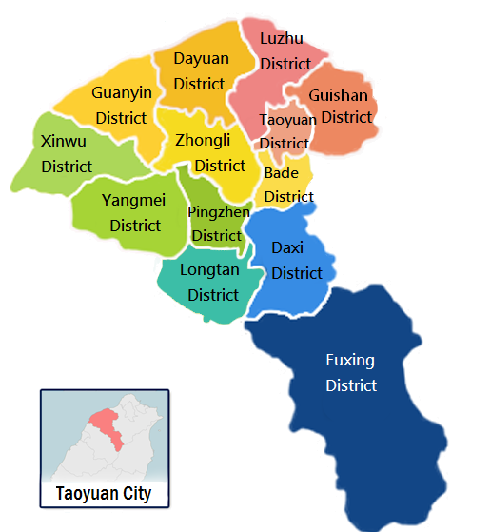
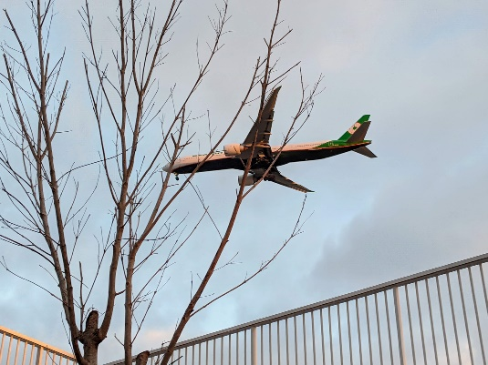


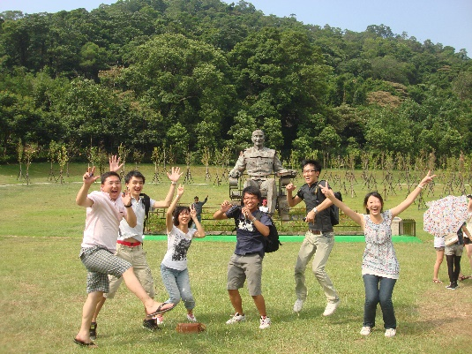
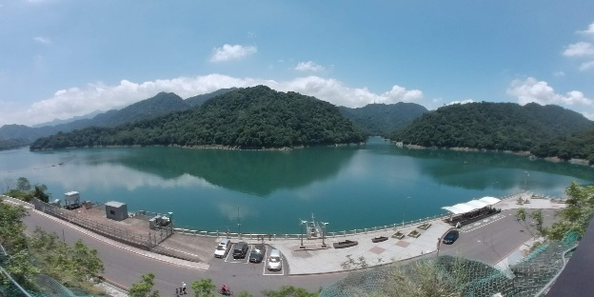
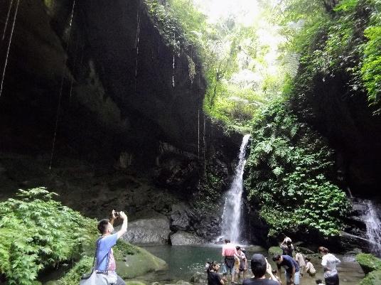
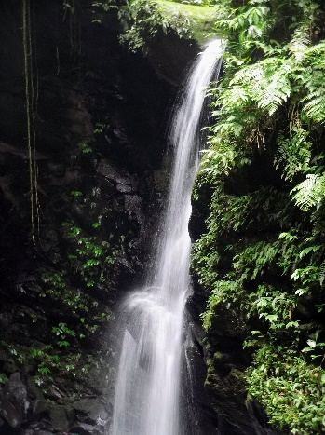
Taiwan Briefing

Slide 11
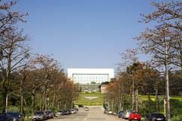


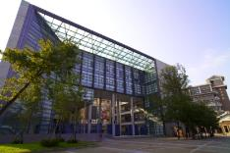
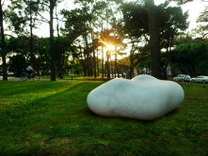
NCU Profile
 | Name | NCU
 | Birth | 1915
Professors & Researchers | 1230
Faculty/ Department | 9 Colleges/32 Departments
Graduate Program | 54 PhD./ 74 Master
Student Body | 12,000
Under : Graduate | 1:1
Partner Universities | 325

Slide 12
NCU Colleges and Programs

Slide 13
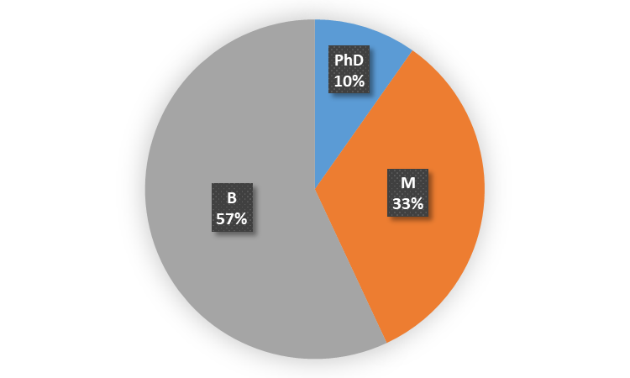
Liberal Arts
 | Bachelor | Master | Doctoral
Chinese Literature | ● | ● | ●
English | ● | ●
French Language & Literature | ● | ●
Interdisciplinary Program of Liberal Arts | ●
History |  | ●
Philosophy |  | ● | ●
Art Studies |  | ●
Learning & Instruction |  | ● | ●
International Master Program in Inter-Asia Cultural Studies |  | ●

Slide 14
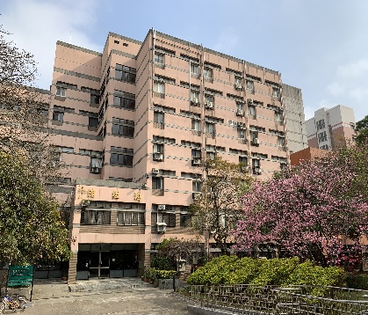
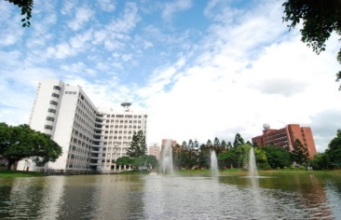
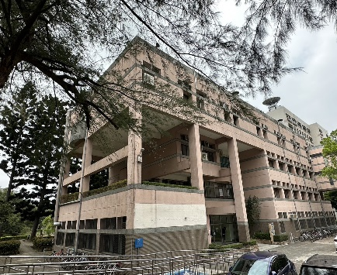
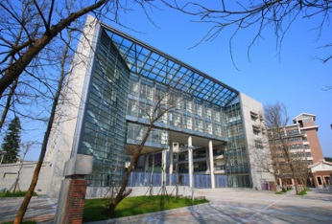
Science
 | Bachelor | Master | Doctoral
Physics | ● | ● | ●
Mathematics | ● | ● | ●
Chemistry | ● | ● | ●
Optics & Photonics | ● | ● | ●
Astronomy |  | ● | ●
Statistics |  | ● | ●

Slide 15
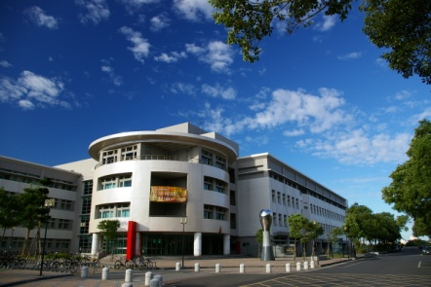
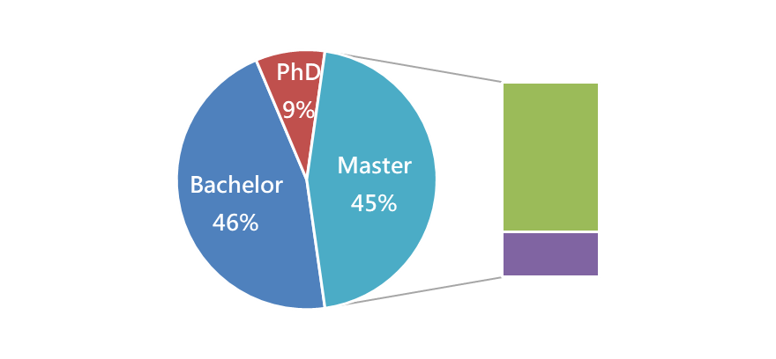
Engineering
 | Bachelor | Master | Doctoral
Interdisciplinary Program, College of Engineering | ●
Chemical & Materials Engineering | ● | ● | ●
Civil Engineering | ● | ● | ●
Mechanical Engineering | ● | ● | ●
Energy Engineering |  | ● | ●
Environmental Engineering |  | ● | ●
Materials Science & Engineering |  | ● | ●
Full-Time
35%
Part-Time
10%

Slide 16
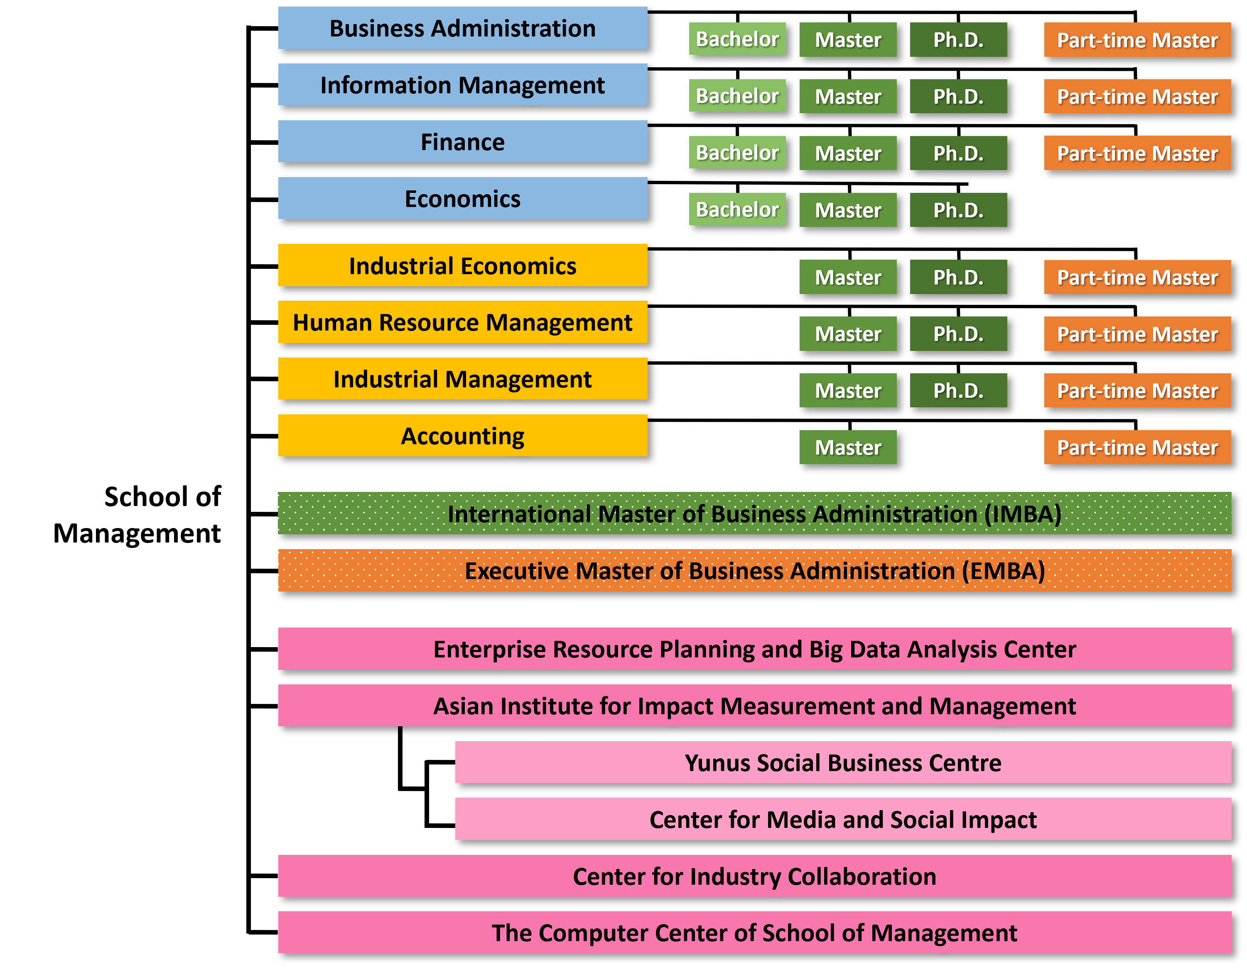

Management
# of Full-time Faculty: 88
Professor: 45
Associate Professor:25
Assistant Professor: 18
# of Students: 2,787
Undergraduate: 1,407
Master: 595
PhD: 127
Part-time Master: 658

Slide 17
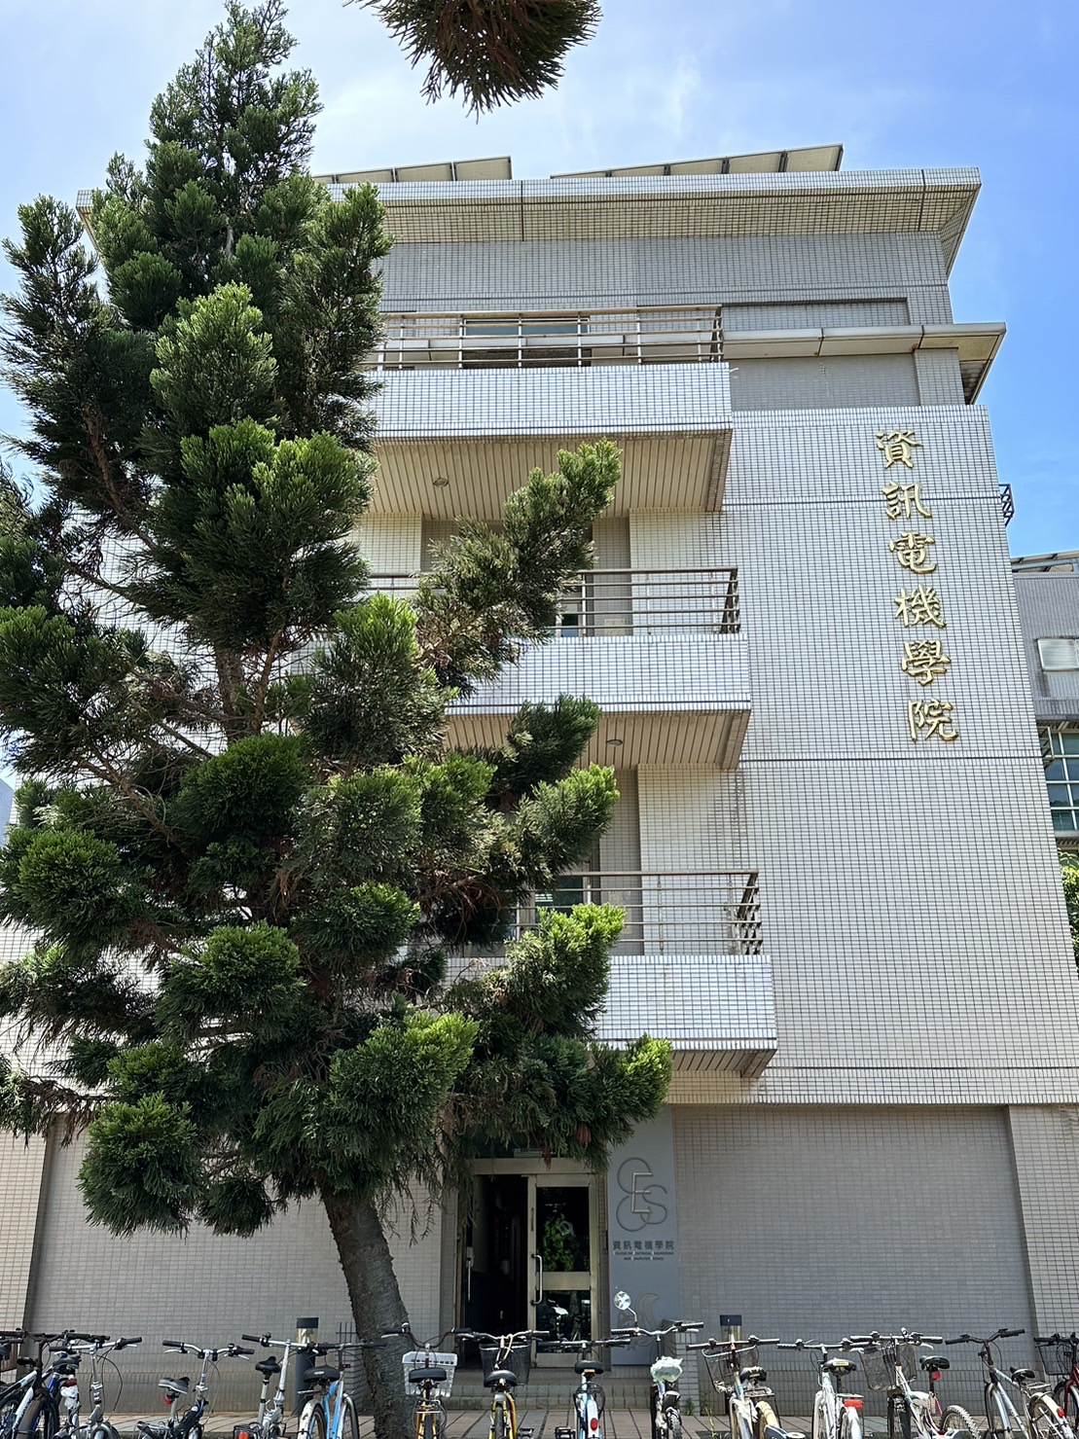
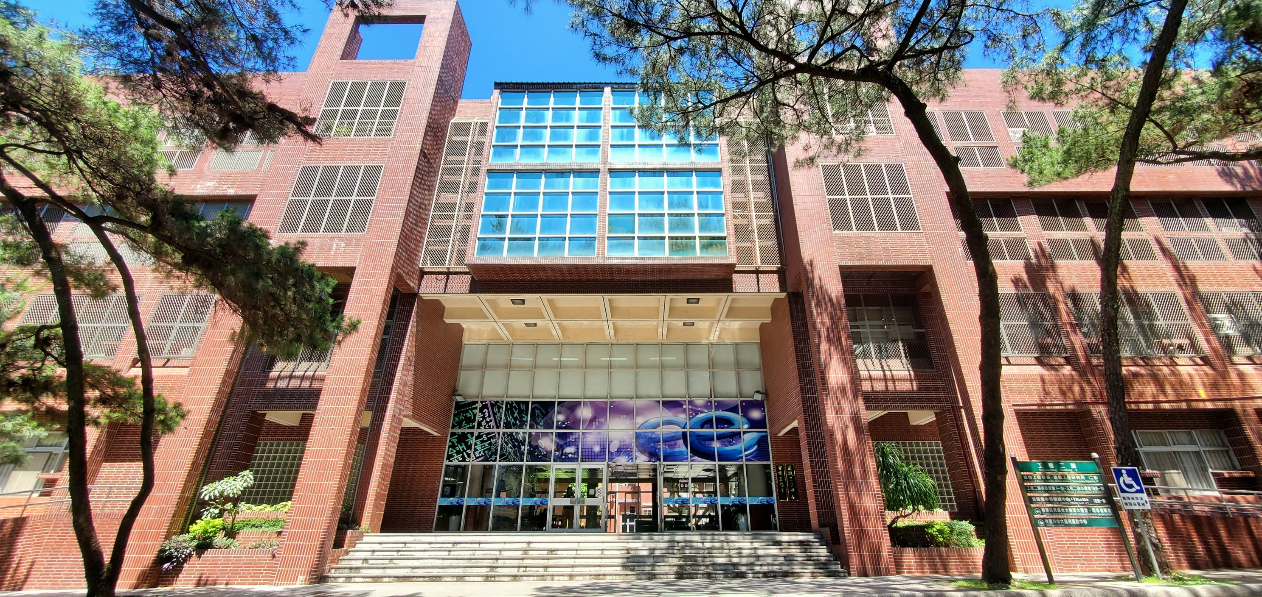

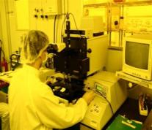
Electrical Engineering and Computer Science
 | Bachelor | Master | Doctoral
Electrical Engineering | ● | ● | ●
Computer Science & Information Engineering | ● | ● | ●
Communication Engineering | ● | ● | ●
Network Learning Technology |  | ● | ●

Slide 18
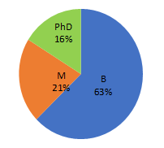
Earth Sciences
 | Bachelor | Master | Doctoral
Earth Sciences | ● | ● Geophysics | ● Geophysics
Atmospheric Physics | ● | ● | ●
Space Science and Engineering | ● | ● | ●
Interdisciplinary Program of Earth System Science | ●
Applied Geology |  | ● | ●
Hydrological & Oceanic Sciences |  | ● | ●

Slide 19

Hakka Studies
 | Bachelor | Master | Doctoral
Hakka Language and Social Sciences | ● | ● | ●
Law and Government |  | ●

Slide 20

Health Sciences & Technology
 | Bachelor | Master | Doctoral
Life Sciences | ● | ● | ●
Cognitive Neuroscience |  | ● | ●
Biomedical Sciences & Engineering | ● | ● | ●
Taiwan International Ph.D. Program in Interdisciplinary Neuroscience |  |  | ●

Slide 21
NCU Exchange Program

Slide 22
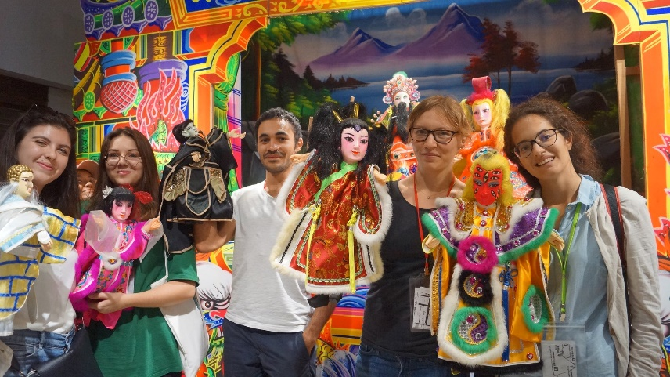
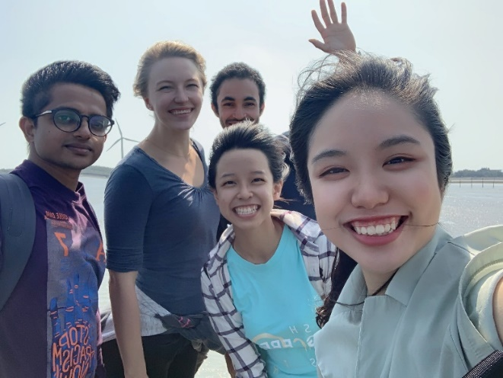
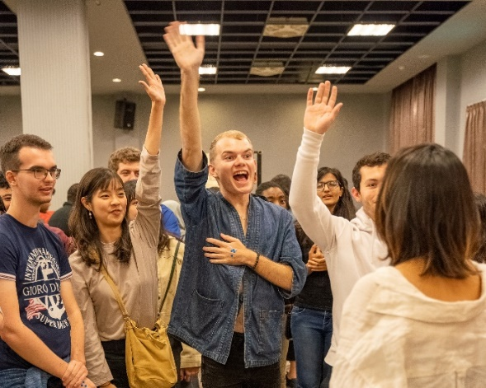
Service
Taiwanese Buddy
Airport Pick-up
Campus Tour and Orientation

Slide 23
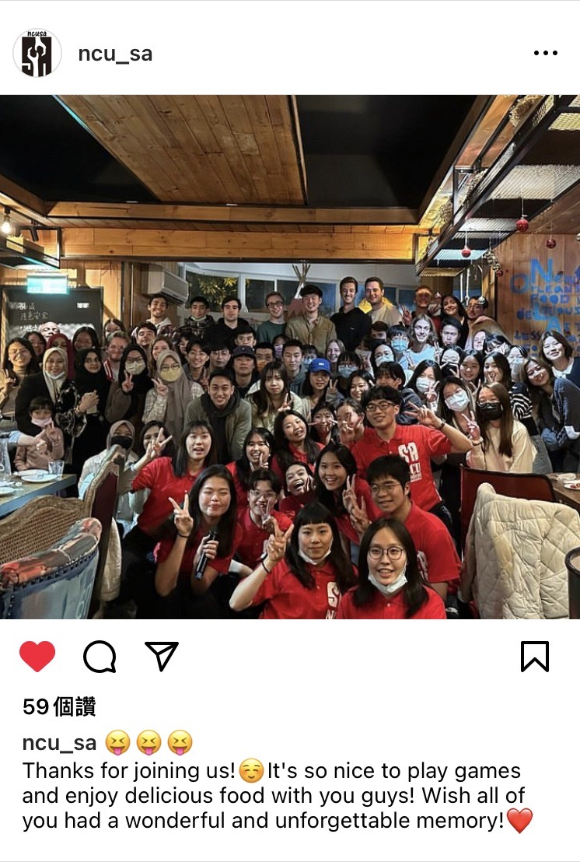
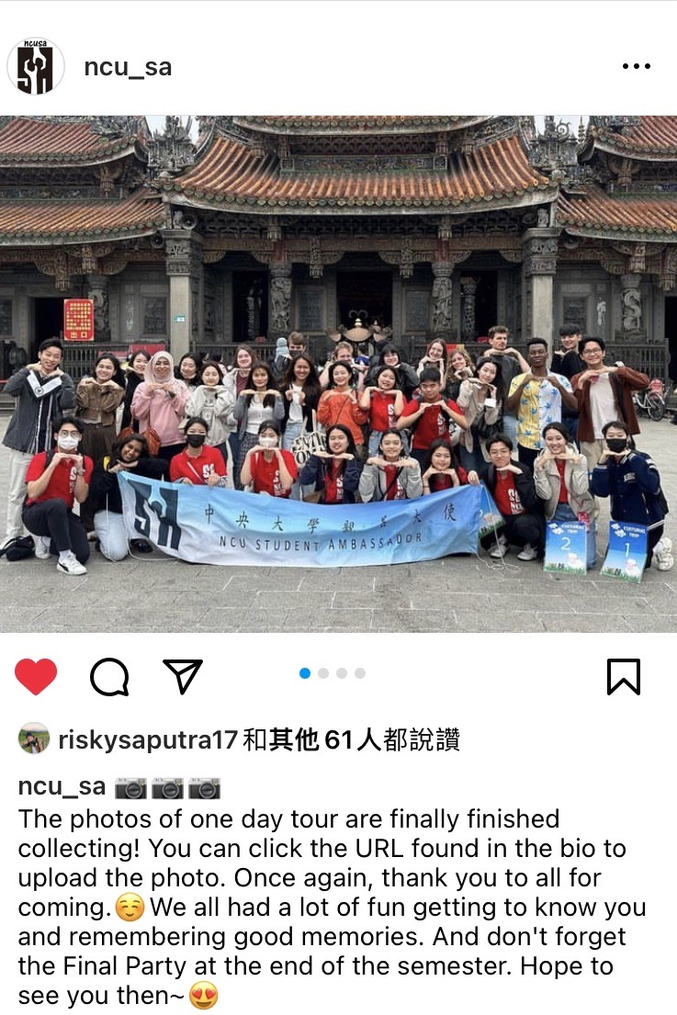
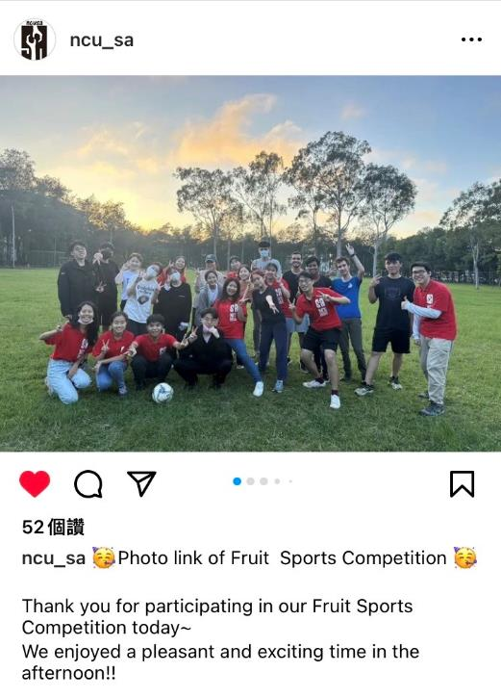
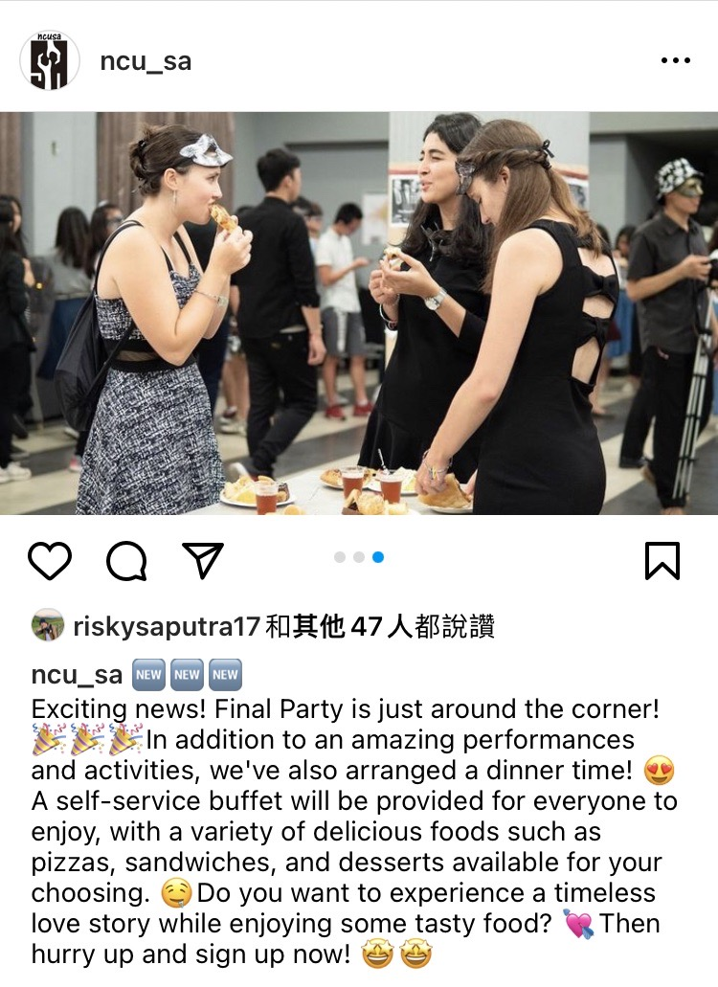
Global Engagement Activities
Welcome Party
One Day Tour to
Attractions in Taiwan
Fruit Sports Competition
Final Party

Slide 24
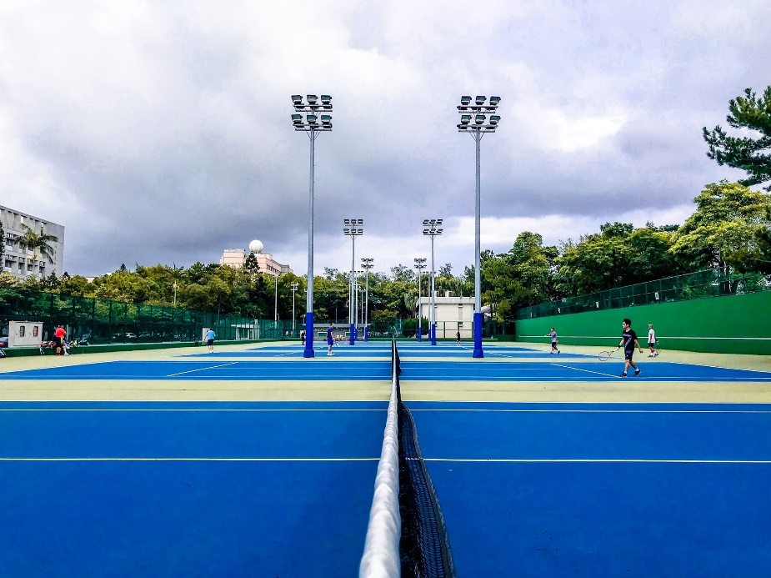
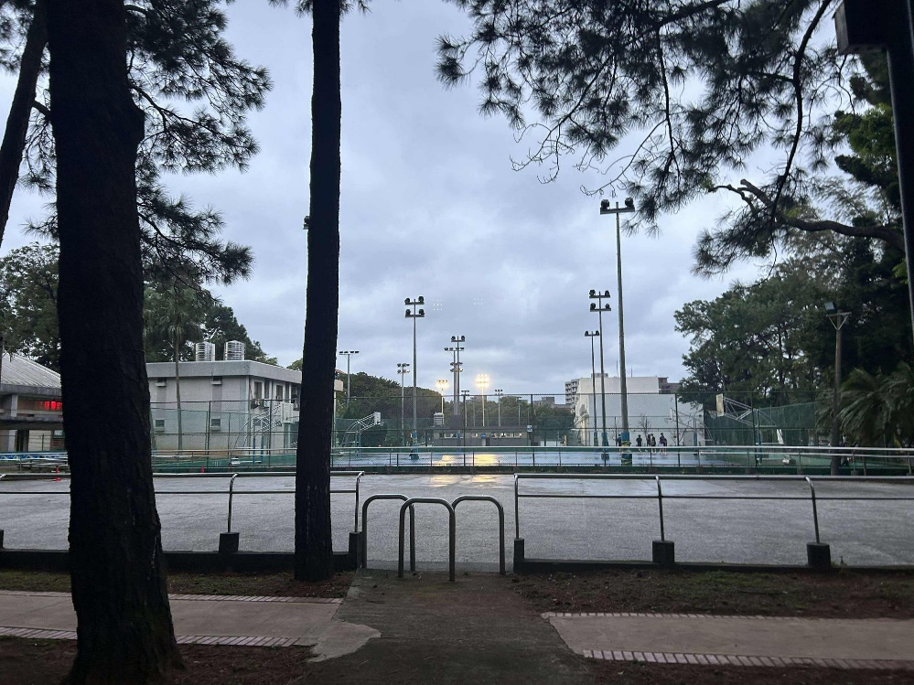
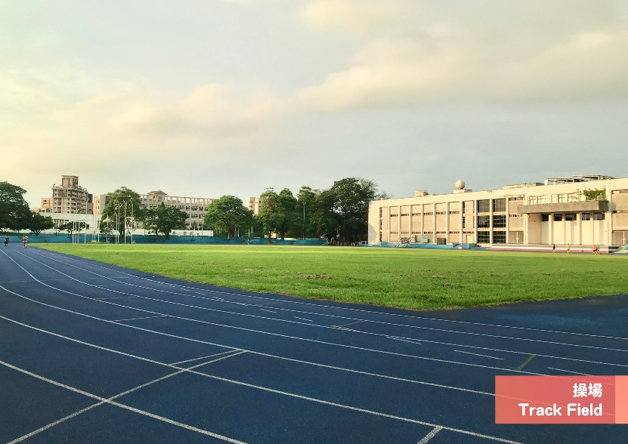
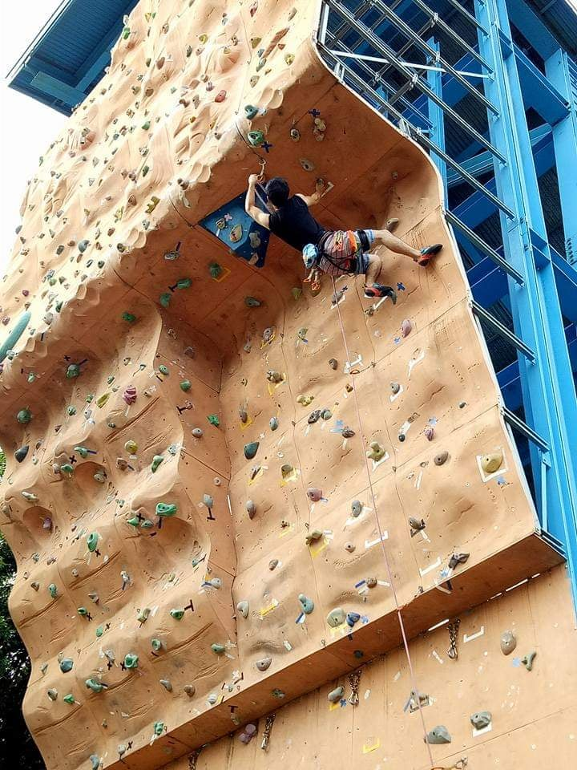
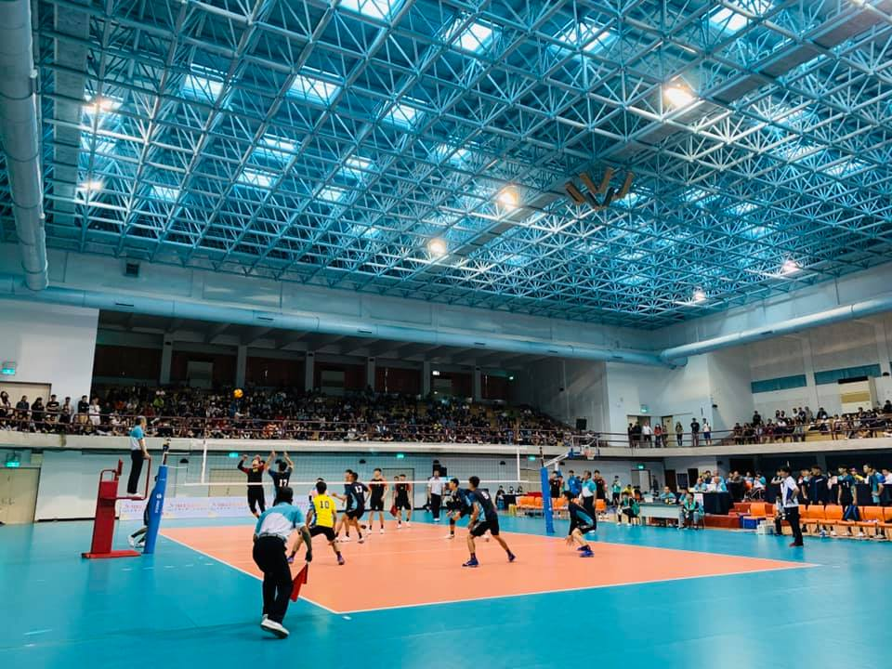
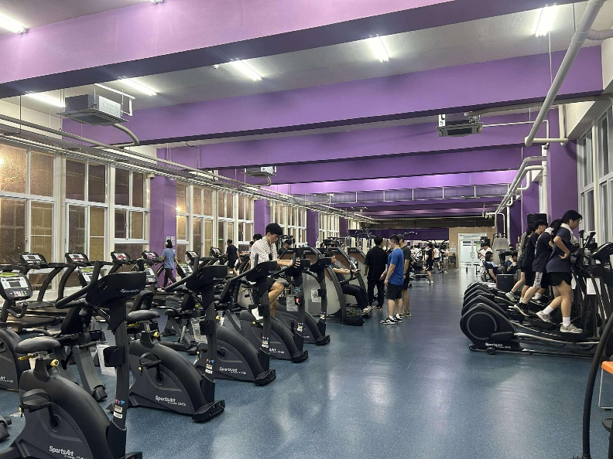
SPORT Facility

Slide 25
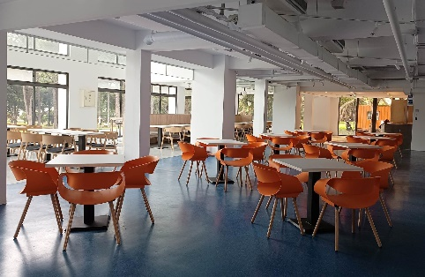










On-campus Dining & Stores

Slide 26





OFF-Campus Housing
Type: Single bedroom (1 person or 2 persons)
Facility: desk, chair, closet, bed, air conditioner, individual bathroom
$135-200/month

Slide 27






On-Campus Dormitory
Type: Shared bedroom
(1 or 2 person or 4 person)
Facility: desks, closets, bed (without mattress) hanging fan, air conditioner, internet access, bathroom
Warm, bright and comfortable!
On-campus Dormitory
Undergraduate/Room for 1 or 2 or 4 persons
 | Each Semester | Summer Vacation | Winter Vacation
Male | US$210- US$600 | US$129- US$367 | US$35- US$100
Female | US$210- US$450 | US$129- US$275 | US$35- US$75
Graduate / Room for 1 or 2 or 4 persons
 | Fall Semester Sept. 1~Jan. 31 | Spring Semester Feb. 1~Aug.31 | The following fee is subject to change and it does not include the internet and air-conditioning cost.
Male | US$256- US$1,084 | US$358- US$1,517
Female | US$334-US$1,084 | US$467- US$1,517
Refrigerator
Kitchen Area
Dormitory Lounge
Laundry Room

Slide 28



Estimate Cost at NCU
Item | Cost /half year(USD)
Textbooks & Learning Materials | 180
Food | 1800 (300/month)
Off-Campus Accommodation (single room) | 900 (150/month)
NCU Student Insurance fee & Internet | 30
Total | 2910
*Estimated Rate: US$1 = NT30
*Tuition waived
*Other Personal Expense not Included
*Students who do not provide the proof of the health insurance overseas will need to pay for the Insurance here (around USD 170)

Slide 29



Wanted: Exchange Student!
When
Application Deadline:
Fall Semester—April 30
Spring Semester--October 30
Length of study:1 semester or 2 semesters
Fall Semester: Mid-September to Mid-January
Spring Semester: Mid-February to Mid-to-end June
Academic
Calendar
Nominated by Home University via e-mail
Online Application
Official historical transcript issued by Home University
Letter of Recommendation
Copy of information page of passport
Digital image of passport photo: it should be in JPEG file
How
*All the required documents should be written in English or Chinese.

Slide 30


Where to find Information
Information Website
https://www.oia.ncu.edu.tw/index.php/en/prospective-students/exchange-programs.html
Application Website
https://ncuies.ncu.edu.tw/
More Info on NCU and Taiwan
Search us on “NCUIS dream”
Contact: Ms. Chen
E-mail: ncuies@g.ncu.edu.tw
Phone:+886-3-425-4945

Slide 31

Message from VP for International Affairs
Dear Future Exchange Students,
Warm greetings from National Central University! We are delighted by your interest in joining our vibrant and diverse academic community. At NCU, we believe that international exchange is more than just studying abroad—it’s about expanding your horizons, embracing new cultures, and building lifelong connections.
As an exchange student at NCU, you will have access to top-tier education, engaging faculty, and a supportive environment that fosters both academic and personal growth. Beyond the classroom, you’ll experience Taiwan’s rich culture, warm hospitality, and vibrant lifestyle.
We look forward to welcoming you and sharing this incredible journey together. We hope NCU will become your home away from home, and we can't wait to see you on campus!

Slide 32


Join NCU & Have Fun

